Slide 1


Mastering Pandas: From Basics to Expert Level
Powerful Data Analysis & Manipulation with Python
Dated: 14 June 2025
Instructor : Fawad Bahadur
Github: bahadurCorvit

Slide 2



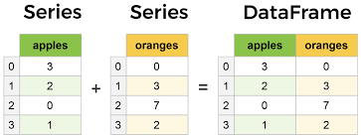
Introduction to Pandas
What is Pandas?
Open-source Python library for data manipulation and analysis.
Provides powerful data structures: Series and DataFrame.
Built on top of NumPy, designed for working with structured data.
Why Use Pandas?
- Easy handling of missing data.
- Flexible reshaping and pivoting.
- Powerful group-by functionality.
- Supports time series data.
Example:
import pandas as pd
data = {'Name': ['Alice', 'Bob', 'Charlie'], 'Age': [25, 30, 35]}
df = pd.DataFrame(data)
print(df)

Slide 3

Setting Up Pandas in Your Environment
Prerequisites-
Python installed (preferably 3.6 or above)
pip (Python package installer)
Installation Using pip:
pip install pandas
Verify Installation:
import pandas as pd
print(pd._version_)

Slide 4
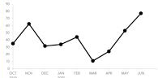
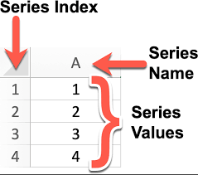
Pandas Series
What is a Series?
- One-dimensional labeled array.
- Can hold any data type (integers, strings, floats, etc.).
- Labels (index) identify each element.
Creating a Series
import pandas as pd
s = pd.Series([10, 20, 30, 40], index=['a', 'b', 'c', 'd'])
print(s)
Accessing Data
print(s['b']) # 20
print(s[1]) # 20 (by position)
Series Attributes
Values: returns the data as NumPy array
Index: returns the index labels
Tip
Series is the building block for DataFrame columns.

Slide 5
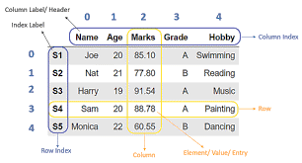
Pandas DataFrame Basics
What is a DataFrame?
Two-dimensional labeled data structure with columns of potentially different types.
Like a spreadsheet or SQL table.
Creating a DataFrame
import pandas as pd
data = {
'Name': ['Alice', 'Bob', 'Charlie'], 'Age': [25, 30, 35],
'Salary': [50000, 60000, 70000]
}
df = pd.DataFrame(data)
print(df)
Accessing Columns
print(df['Name']) # Returns Series of names
Accessing Rows By
index label: df.loc[0]
By integer position: df.iloc[0]
Tip
DataFrame is the core structure for data analysis in Pandas.
Instructor : Fawad Bahadur

Slide 6
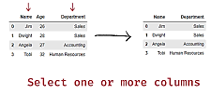
Data Selection & Indexing?
Selecting Columns
df['Age'] # Single column (Series)
df[['Name', 'Age']] # Multiple columns (DataFrame)
Selecting Rows
Using .loc (label-based)
df.loc[0] # First row by index label
df.loc[0:2] # Rows 0 to 2 inclusive
Using .iloc (integer position-based)
df.iloc[0] # First row by position
df.iloc[0:2] # Rows 0 and 1
Tip
Use .loc for label indexing and .iloc for positional indexing.
Setting Values
df.loc[1, 'Salary'] = 65000

Slide 7
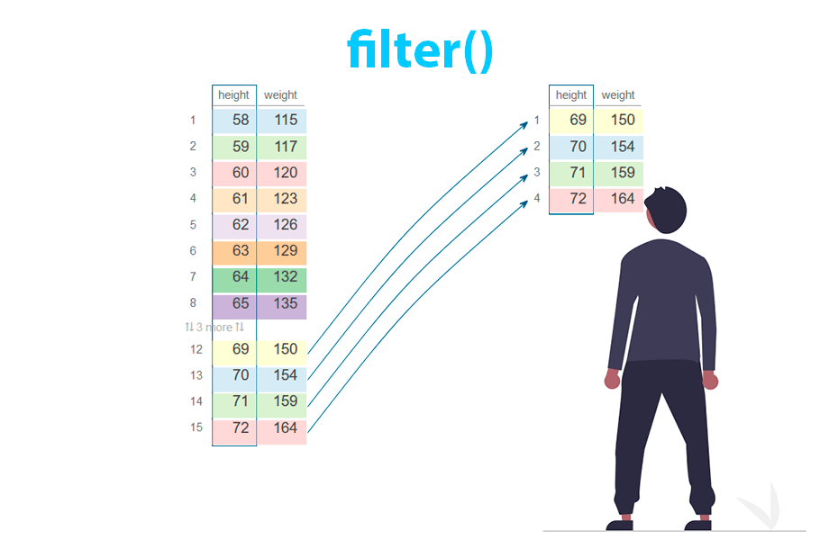
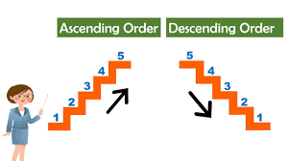
Conti…
Aditional Selection
df[df['Age'] > 25] # Filter rows
Sort Ascending
df.sort_values(‘Age’)
Sort Descending
df.sort_values(‘Age’, ascending=False)

Slide 8
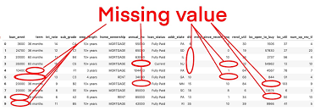
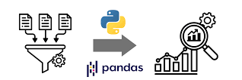
Handling Missing Data?
Detecting Missing Data
df.isnull() # Returns DataFrame of True/False for missing values
Count missing values per column
df.isnull().sum()
Remove NaNs
Df.dropna()
Replace NaNs
Df.fillna(0)
Drop Columns
Df.drop(‘col’, axis=1)
Tip
Clean and transform your data to prepare it for analysis.

Slide 9

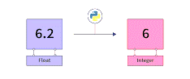
Conti…
Rename
Df.rename(columns={‘old’:‘new’}
Changing Data Types
df['Age'] = df['Age'].astype(float)
Removing Duplicates
df.drop_duplicates(inplace=True)
df.drop_duplicates(subset=['ID', 'Email'], inplace=True)
Tip
Clean and transform your data to prepare it for analysis.

Slide 10
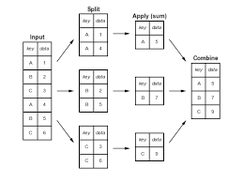
Data Aggregation & Grouping
GroupBy Basics
- Split data into groups based on column values.
- Apply aggregation functions.
Common Aggregation Functions
- .sum()
- .mean()
- .count()
- .min()
- .max()
Example
grouped = df.groupby('AgeGroup')
print(grouped['Income'].mean())
Multiple Aggregations
grouped['Income'].agg(['mean', 'max', 'min'])
Tip
GroupBy is powerful for summarizing data by categories.

Slide 11
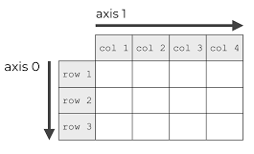
Concatenation in Pandas
Purpose
Used to stack DataFrames or Series vertically or horizontally along an axis.
Functionality
Combines DataFrames by appending them along a specified axis (rows or columns).
Does not perform any relational operations or key-based joining.
Can handle DataFrames with different columns or indices.
Can result in duplicate indices if not handled properly.
Use Case
When you want to combine DataFrames with similar structures or append new data to existing DataFrames without considering common keys.
Code
pd.concat([df1, df2], axis=0) # Vertical (rows)
pd.concat([df1, df2], axis=1) # Horizontal (columns)

Slide 12
Merge in Pandas
Purpose
Used to combine DataFrames based on common columns or indices, similar to SQL joins.
Join Type | Syntax | Returns
Inner | how='inner' | Only matching rows
Left | how='left' | All left rows + matching right
Right | how='right' | All right rows + matching left
Outer | how='outer' | All rows from both
Functionality
Merges two DataFrames based on specified columns or indices.
Supports different types of joins: inner, outer, left, right.
Can handle complex merging scenarios with multiple keys.
Can result in duplicate columns if not handled properly.
Use Case
When you want to combine DataFrames based on related columns, similar to joining tables in a database.
Code
pd.merge(df1, df2, on='key', how='inner') # Inner join
pd.merge(df1, df2, on='key', how='left') # Left join
Tip
Use merging and joining to combine related datasets effectively.

Slide 13
Join in Pandas
Purpose
A specialized version of merge() optimized for joining DataFrames based on their indices or key columns.
Join Type | Syntax | Returns
Inner | how='inner' | Only matching rows
Left | how='left' | All left rows + matching right
Right | how='right' | All right rows + matching left
Outer | how='outer' | All rows from both
Functionality
Combines two DataFrames based on indices or specified key columns.
By default, performs a left join, but other types can be specified
Can be more efficient than merge() when joining on indices.
Use Case
When you want to combine DataFrames based on their indices or specific key columns, similar to joining tables in a database but with a focus on index-based joins.
Code
df1.join(df2, how='outer')
Tip
Use merging and joining to combine related datasets effectively.

Slide 14
Working with Time Series Data
DateTime Index
Use pd.to_datetime() to convert columns to datetime.
df['Date'] = pd.to_datetime(df['Date'])
df.set_index('Date', inplace=True)
Resampling
Aggregate time series data at different frequencies.
df.resample('M').mean() # Monthly average
Time-based Selection
df.loc['2023-01-01':'2023-01-31']
Shifting Data
df['PrevDay'] = df['Value'].shift(1)
Tip
Pandas makes time series manipulation intuitive and powerful.

Slide 15

Handling Text Data in Pandas
String Methods
- Use .str accessor for vectorized string operations.
df['Name'].str.lower() # Convert to lowercase
df['Name'].str.contains('a') # Check if 'a' in string
Extracting Substrings
df['Initial'] = df['Name'].str[0]
Splitting Strings
df['Name'].str.split(' ')
Replacing Text
df['Name'] = df['Name'].str.replace('Alice', 'Alicia')
Tip
Text processing in Pandas is efficient and easy with .str methods.

Slide 16
Pivot Tables & Crosstabs in Pandas
Pivot Tables
Summarize data with multiple aggregation levels.
pd.pivot_table(df, values='Income', index='AgeGroup', columns='Gender', aggfunc='mean')
Crosstabs
Compute frequency tables.
pd.crosstab(df['AgeGroup'], df['Gender'])
Benefits
Easy multi-dimensional summaries.
Useful for exploratory data analysis.
Tip
Pivot tables help you quickly understand relationships between variables.

Slide 17
Reading & Writing Data with Pandas
Reading Data
CSV files
df = pd.read_csv('data.csv’)
Excel files
df = pd.read_excel('data.xlsx', sheet_name='Sheet1’)
JSON files
df = pd.read_json('data.json’)
Writing Data
To CSV
df.to_csv('output.csv', index=False)
To Excel
df.to_excel('output.xlsx', index=False)
Tip
Pandas supports many file formats for easy data import/export.

Slide 18
Advanced Indexing in Pandas
Setting MultiIndex
df.set_index(['AgeGroup', 'Gender'], inplace=True)
Accessing MultiIndex Data
df.loc[('Adult', 'Male')]
Resetting Index
df.reset_index(inplace=True)
Using .at and .iat for Fast Scalar Access
df.at[0, 'Name'] # Access by label
df.iat[0, 1] # Access by position
Tip
Advanced indexing allows for powerful, flexible data selection.

Slide 19
Categorical Data in Pandas
What are Categorical Variables?
Variables with a fixed number of possible values (categories).
Saves memory and improves performance.
Converting to Category
df['Gender'] = df['Gender'].astype('category')
Benefits
Efficient storage.
Faster operations.
Useful for grouping and analysis.
Categories and Codes
print(df['Gender'].cat.categories)
print(df['Gender'].cat.codes)
Tip
Use categorical dtype for columns with repeated values.

Slide 20
Handling Large Datasets in Pandas
Techniques to Handle Big Data
Use chunksize parameter while reading files
for chunk in pd.read_csv('large_data.csv', chunksize=10000):
process(chunk)
Filter Early
Filter data before heavy processing to reduce size.
Use Efficient Data Types
Convert object columns to categorical.
Downcast numeric types.
df['Age'] = pd.to_numeric(df['Age'], downcast='integer')
Use .query() for Faster Filtering
df.query('Age > 30 & Gender == "Male“’)
Tip
Optimize memory and processing to work with large data smoothly.

Slide 21
Advanced Missing Data Techniques
Interpolation
Fill missing values using interpolation methods.
df['Value'].interpolate(method='linear', inplace=True)
Forward & Backward Fill
df.fillna(method='ffill', inplace=True) # Forward fill
df.fillna(method='bfill', inplace=True) # Backward fill
Filling Missing with Conditional Values
df.loc[df['Value'].isnull(), 'Value'] = df['Value'].mean()
Detecting Missing Data with .info()
df.info()
Tip
Choose the appropriate method based on data context.

Slide 22
Efficient Function Application in Pandas
Using .apply()
Apply a function along axis of DataFrame or Series.
df['Income_K'] = df['Income'].apply(lambda x: x / 1000)
Using .map()
Map values of a Series according to an input correspondence.
df['AgeGroup'] = df['Age'].map(lambda x: 'Adult' if x >= 18 else 'Minor')
Using Vectorized Operations
Prefer built-in vectorized functions for speed.
Using .agg() for Multiple Aggregations
df.groupby('AgeGroup')['Income'].agg(['mean', 'max'])
Tip
Vectorized and built-in functions outperform custom Python loops.

Slide 23
Reshaping Data: Melt & Pivot
Melt (Wide to Long Format)
Converts wide data into long format.
pd.melt(df, id_vars=['Name'], value_vars=['Age', 'Income'])
Pivot (Long to Wide Format)
Converts long data back to wide format.
df.pivot(index='Name', columns='variable', values='value')
Use Cases
Useful for preparing data for analysis or visualization.
Tip
Master reshaping to handle diverse data formats efficiently.

Slide 24
MultiIndex DataFrames in Pandas
What is MultiIndex?
Hierarchical indexing with multiple levels of rows and/or columns.
Accessing Data
df.loc['A'] # All rows under 'A’
df.loc[('A', 'one')] # Specific row
Creating MultiIndex
arrays = [['A', 'A', 'B', 'B'], ['one', 'two', 'one', 'two’]]
index = pd.MultiIndex.from_arrays(arrays, names=('Letter', 'Number’))
df = pd.DataFrame({'Data': [1, 2, 3, 4]}, index=index)
Resetting MultiIndex
df.reset_index(inplace=True)
Tip
MultiIndex is powerful for representing complex datasets.

Slide 25
Optimizing Pandas Performance
Use Vectorized Operations
Avoid loops
use built-in Pandas/NumPy functions.
Use .query() and .eval()
Faster filtering and evaluation.
df.query('Age > 30 & Income > 50000')
Use Categorical Data Type
Reduce memory and speed up operations on repeated values.
Avoid Chained Indexing
Use .loc instead for safe and efficient assignment.
Downcast Numeric Types
df['Age'] = pd.to_numeric(df['Age'], downcast='integer')
Tip
Efficient coding drastically improves speed on large data..

Slide 26
Customizing Pandas Display & Behavior
Display Options
pd.set_option('display.max_rows', 100)
pd.set_option('display.max_columns', 20)
pd.set_option('display.float_format', '{:.2f}'.format)
Performance-related Options
Control chunk size, engine type in reading files
Memory Usage Display
df.info(memory_usage='deep')
Reset to Default
pd.reset_option('all')
Tip
Customize options to make data viewing and processing easier.

Slide 27
Pandas Integration with Other Libraries
NumPy
Pandas is built on NumPy arrays, enabling fast numerical operations.
import numpy as np
arr = np.array([1, 2, 3])
df = pd.DataFrame(arr)
Scikit-learn
For machine learning pipelines.
from sklearn.model_selection import train_test_split
X_train, X_test, y_train, y_test =
train_test_split(df.drop('target', axis=1), df['target'])
Matplotlib & Seaborn
For data visualization.
df['Age'].plot(kind='hist’)
import seaborn as sns
sns.boxplot(data=df, x='Age')
SQLAlchemy
Read/write data from SQL databases.
from sqlalchemy import create_engine
engine = create_engine('sqlite:///:memory:’)
df.to_sql('table_name', engine)
Tip
Pandas works seamlessly with the Python data ecosystem.

Slide 28
Advanced Time Series Techniques in Pandas
Rolling Windows
Calculate rolling statistics.
df['RollingMean'] = df['Value'].rolling(window=3).mean()
Time Zone Handling
df.index =
df.index.tz_localize('UTC').tz_convert('Asia/Karachi')
Expanding Windows
Cumulative calculations.
df['ExpandingSum'] = df['Value'].expanding().sum()
Time Shifts & Lags
df['Lag1'] = df['Value'].shift(1)
Tip
Master these for complex time series analysis.

Slide 29
Handling JSON & Nested Data in Pandas
Reading JSON Files
df = pd.read_json('data.json')
Normalizing Nested JSON
from pandas import json_normalize
data = [{'id': 1, 'info': {'name': 'A', 'age': 30}}]
df = json_normalize(data, sep='_')
Flattening Nested Columns
Access nested fields as separate columns.
df[['info_name', 'info_age']]
Writing JSON
df.to_json('output.json', orient='records', lines=True)
Tip
Use json_normalize to convert complex JSON into flat DataFrames.
Instructor : Fawad Bahadur

Slide 30
Advanced Strategies for Missing Data
Detect Missing Data
df.isnull().sum()
Using Conditional Fillin
df.loc[df['ColumnName'].isnull(), 'ColumnName'] = df['ColumnName'].mean()
Dropping Missing Values
df.dropna(subset=['ColumnName'], inplace=True)
Advanced Imputation Techniques
- Use libraries like sklearn.impute for sophisticated filling.
Filling with Statistical Values
df['ColumnName'].fillna(df['ColumnName'].median(), inplace=True)
Tip
Proper handling of missing data ensures better analysis results.
Instructor : Fawad Bahadur

Slide 31
Using Custom Functions & Lambda
Applying Custom Functions with .apply()
def categorize_age(age):
if age < 18:
return 'Minor’
else:
return 'Adult’
df['AgeGroup'] = df['Age'].apply(categorize_age)
Lambda Functions for Quick Operations
df['Income_k'] = df['Income'].apply(lambda x: x / 1000)
Using .applymap() for Element-wise DataFrame Ops
df_numeric = df.select_dtypes(include='number’)
df_numeric = df_numeric.applymap(lambda x: x*2)
Tip
Use custom and lambda functions to flexibly manipulate data.
Instructor : Fawad Bahadur

Slide 32
Advanced MultiIndex Operations
Swapping Level
df.swaplevel('Level_1', 'Level_0', axis=0)
Sorting by Index Levels
df.sort_index(level=1, ascending=False)
Indexing with pd.IndexSlic
idx = pd.IndexSlice
df.loc[idx[:, 'B'], :]
Aggregations on MultiIndex
df.groupby(level='Level_0').sum()
Tip
Master these to handle complex, hierarchical datasets with ease.
Instructor : Fawad Bahadur

Slide 33
Data Visualization Using Pandas
Basic Plotting
df['Age'].plot(kind='hist', bins=20, title='Age Distribution')
Line Plot
df.plot(x='Date', y='Sales', kind='line')
Bar Plot
df['Category'].value_counts().plot(kind='bar')
Scatter Plot
df.plot.scatter(x='Age', y='Income')
Using matplotlib and seaborn for Enhanced Visualization
sns.boxplot(x='Category', y='Income', data=df)
Tip
Pandas integrates well with visualization libraries for exploratory analysis.
Instructor : Fawad Bahadur

Slide 34


Exporting Data & Automation in Pandas
Export Data
To CSV
df.to_csv('output.csv', index=False)
To Excel
df.to_excel('output.xlsx', index=False)
To JSON
df.to_json('output.json', orient='records')
Automate Tasks with Scripts
Schedule scripts using cron (Linux) or Task Scheduler (Windows).
Use Python scripts to automate data cleaning and reporting.
Example: Save filtered data daily
filtered = df[df['Age'] > 30]
filtered.to_csv('filtered_data.csv', index=False)
Converting Between NumPy and Tensors
TensorFlow and PyTorch tensors can be converted to/from NumPy arrays seamlessly.
Tip
Automating pandas workflows saves time and reduces errors.
Instructor : Fawad Bahadur

Slide 35
Summary
Summary
Covered Pandas basics to advanced topics:
Data structures & indexing
Data cleaning & manipulation
Grouping, merging & reshaping
Time series & categorical data
Performance optimization & visualization
Integration & automation
Instructor : Fawad Bahadur

Slide 36

Q & A
Instructor : Fawad Bahadur

Slide 37
THANK YOU
Instructor : Fawad Bahadur

